Slide 1
Project Delta Airlines
By Huss Issa, David Wu Ricardo Benitez, Matt Kenney

Slide 2
Motivation and Summary
The “Delta Airlines” presentation is a collaboration to dig into pre and post pandemic Delta Airlines data to gather insights from passenger traffic, freight volume, major routes and competing carriers with Delta Airlines.

Slide 3
Questions & Data
How was Delta Airlines business travel effected?
When did travel confidence return ?
Was Holliday travel badly effected by the pandemic fear ?
Did Delta freight volume increase against passenger volume decline?
Data limitation with only January 2021 being available during time of project.
Certain sample criteria with “Carriers” were eliminated as “desti” aren’t available
We utilized Arima forecasting to timeframe the Delta data to make predictive modeling.

Slide 4
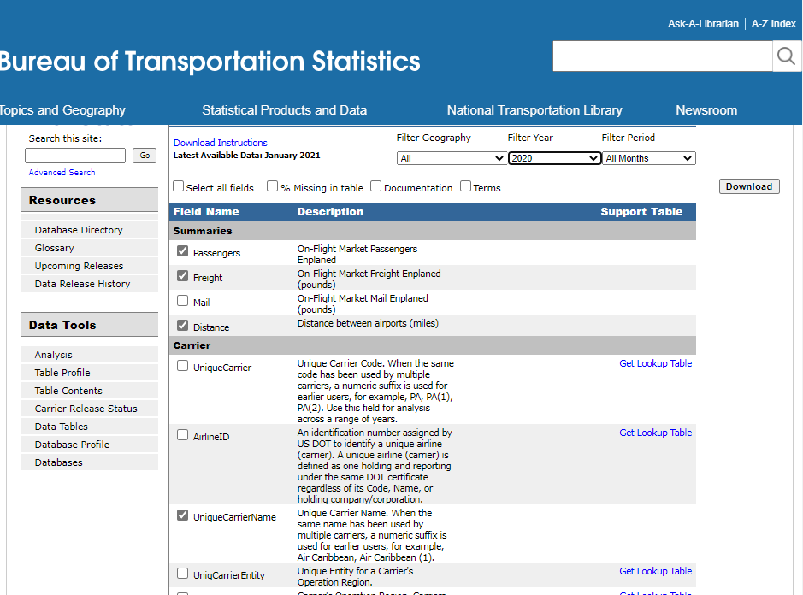
Data Exporation and Cleanup
The Data we acquired was relatively clean because the database was an Airline Database based on government data OST_R | BTS | Transtats
The Data Cleanup process included selecting the relevant columns from the website, and downloading the data

Slide 5
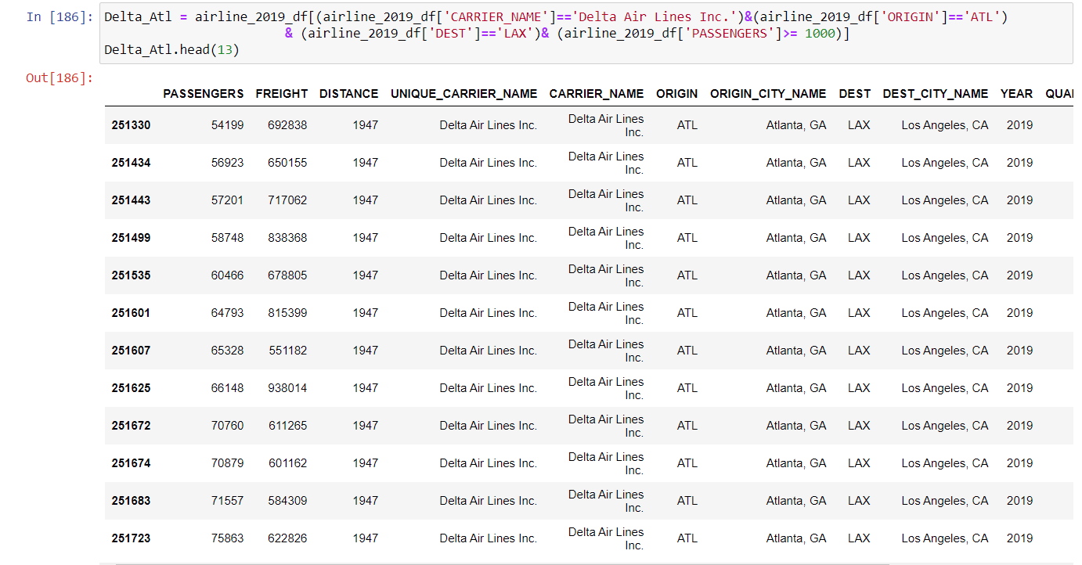
Data Exploration and Cleanup
Afterwards we selected the rows we needed for through Jupyter notebooks.
Then sorted the data by month (numerical 1 to 12)
We did this for both the 2019 and 2020 data so that we could have a comparison.

Slide 6
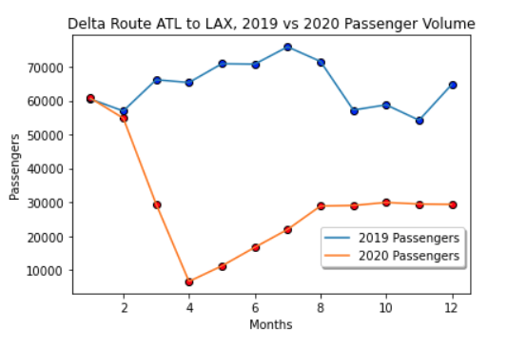
Data Analysis: Sample Atlanta to Los Angeles, Delta Passenger Volume
From what we gather for the comparison aggregated 2019 and 2020 data for Delta Airlines, Atlanta to Los Angeles, for this route in 2019 travel had a higher volume during the summer months.
During March to April of 2020 there was a significant drop off in passengers for this route because of the impact of Covid-19
By August of 2020, passenger travel resumed to a bit less than 50 percent capacity, because of social distancing measures implemented by the company.

Slide 7
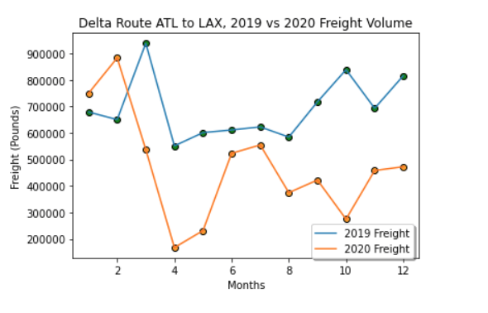
Comparison of Freight Data Atlanta to Los Angeles 2019 to 2020
The Freight data doesn’t appear to be as affected between 2019 and 2020.
During 2020, there was an initial dropoff in volume as airlines were grounded, however during the summer months, volume appeared to temporarily return closer to normal.
For this route, during the higher volume months of October to December, companies comparatively chose not to use as much Delta Air Freight as that of the previous year.

Slide 8
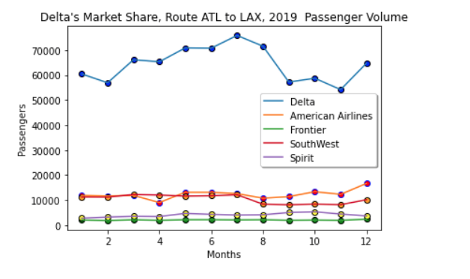
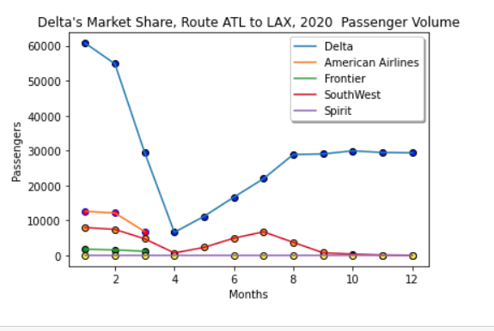
Market Position, Delta vs Competitors
Delta is normally a dominant player for this route, because Atlanta is its hub
During 2019, we show that American Airlines began to slowly increase their volume during the winter months.
This however immediately ceased during Covid when American Airlines ended this route.
During 2020 the only major airline to significantly attempt to take market share away from Delta is Southwest
Delta remains the Dominant player for this route.

Slide 9
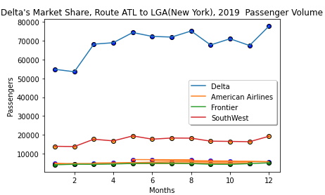
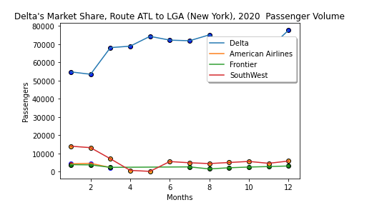
Delta’s Domination
Flights from ATL to LGA (New York) Delta is Flying above all its competitors in passenger volume by more than 40,000 more passenger volume 37.5% more than its closest competitor which remained consistent as 2019 Data not changing in 2020 Pandemic.
In the Holliday season between October and December for 2020 Delta soared above Competitors in the Month of Vaccinations (December 2020) American Airlines, Frontier, SouthWest) fell off significantly with SouthWest dropping near lower competitor's volume.

Slide 10
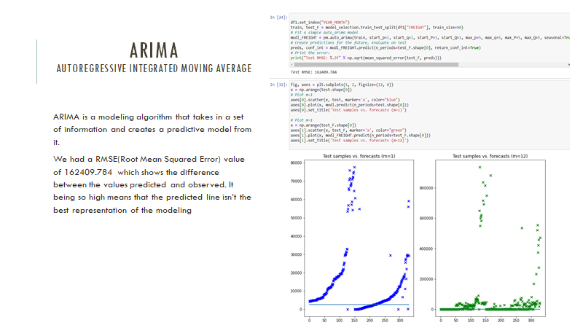
DISCUSSION and post mortem

